Slide 1

We don't take kindly to your types around here!
Graham Sutherland
Portcullis Computer Security
www.portcullis-security.com

Slide 2
What?
Serialisation
Languages
  PHP
  C#
  Java (briefly)
  Ruby
Attacks
Solutions

Slide 3
Who?
Graham Sutherland
@gsuberland
Pentester at Portcullis
My third Securi-Tay!
Also: BSides London, 44CON, DC4420, EMF
Vociferous drunkard
(we're sponsoring the bar btw)

Slide 4
Portcullis
Pentesting, security consultancy
Been around since 1986, testing since 1996
Watford, Madrid, San Francisco
Web: https://www.portcullis-security.com/
Labs: https://labs.portcullis.co.uk/
We're hiring!

Slide 5

What's serialisation?

Slide 6

{name, age}
{name, age}

Slide 7
Data formats
JSON (and BSON)
BEncode
XML
YAML
Propery List (plist)
Binary (proprietary)

Slide 8
JSON Example
{
“forename”: “Graham”,
“surname”: “Sutherland”,
“handle”: “gsuberland”,
“occupation”: { “title”: “Penetration Tester”,
“employer”: “Portcullis” },
“location”: “Securi-Tay IV”,
“hobbies”: [
“security”, “coding”, “cryptography”, “beer”,
“electronics”, “gaming”, “metal music”, “beer”
]
}

Slide 9
XML Example
<person>
<forename>Graham</forename>
<surname>Sutherland</surname>
<handle>gsuberland</handle>
<occupation>
<title>Penetration Tester</title>
<employer>Portcullis</employer>
</occupation>
<location>Securi-Tay IV</location>
<hobbies>
<hobby>security</hobby>
<hobby>cryptography</hobby>
<hobby>coding</hobby>
<hobby>beer</hobby>
<hobby>electronics</hobby>
<hobby>gaming</hobby>
<hobby>metal music</hobby>
<hobby>beer</hobby>
</hobbies>
</person>

Slide 10
Binary formats
Common: PHP, Java, C#
Proprietary
Usually complex
Often more space efficient than other formats
Sometimes have security-sensitive fields

Slide 11
Serialisation steps
Identification of scope
Capture of values
Handling of references
Collection of metadata *
Normalisation
Formatting

Slide 12
Deserialisation steps
Parsing
Validation
Type identification
Type resolution
Value and reference extraction
Instantiation
Population

Slide 13
Phenomena
All languages: validation logic in getters/setters is bypassed entirely
All languages: incoming types may be unexpected
Most languages: object constructors not called
Some languages: custom (de)serialisation handlers
Some languages: pre/post deserialisation callbacks for certain types, or globally

Slide 14

Main concept

Slide 15
PHP-specific features
__destruct()
derpy type handling
unserialize_callback_func
__wakeup()
__autoload()
__call()
__get(), __set()
__unset(), __isset()

Slide 16
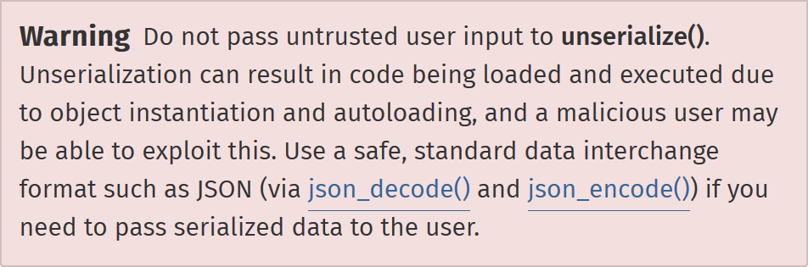
PHP unserialize()

Slide 17

(side note)
PHP doesn't handle UTF-8 properly* in json_decode()
which can lead to some funky security issues relating
to filtering of user input, e.g. XSS / SQL injection.

Slide 18
PHP: Destructor
class TempUpload
{
public $guid = “”;
public function __construct($guid, $data)
{
$this->guid = $sid;
$db->query(
“INSERT INTO files (guid, data) VALUES (?,?)”,
$guid, $data
);
}
public function __destruct()
{
$db->query(“DELETE FROM files WHERE guid = ?“, $this->guid);
}
}

Slide 19
PHP: Type derping
class Event
{
public $id = 0;
public function __construct($id)
{
$this->id = (int)$id;
}
}
$obj = deserialise($_GET['event']);
$sql = “SELECT * FROM events WHERE id = “ . $obj->id;

Slide 20
PHP: Moar type derping [1]
class Event
{
public $id = 0;
public function __construct($id)
{
$this->id = (int)$id;
}
public function __wakeup()
{
$this->id = (int)$this->id;
}
}
$obj = deserialise($_GET['event']);
$sql = “SELECT * FROM events WHERE id = “ . $obj->id;

Slide 21
PHP: Moar type derping [2]
class User
{
public $id = “”;
public $email = “”;
// ...
}
$obj = deserialise($_GET['event']);
$sql = “SELECT * FROM events WHERE id = “ . $obj->id;

Slide 22
PHP: Global callback
function ds_callback($classname)
{
$path = '/var/www/tmp/deserialize-debug.log';
$fp = fopen($path, 'a');
$fwrite($fp, $classname);
fclose($fp);
}
ini_set('unserialize_callback_func', 'ds_callback');
// ...
$foo = $_GET['foo'];
$bar = deserialize($foo);

Slide 23
PHP: Local callback
class LogRecord
{
private $path = APP_DEFAULT_LOG_PATH;
public $type;
public function __construct()
{
// ...
}
public function save()
{
$fp = fopen($this->path, 'a');
fwrite($fp, 'Log type ' . $this->type . ' passed to API');
fclose($fp);
}
public function __wakeup()
{
$this->save();
}
}

Slide 24
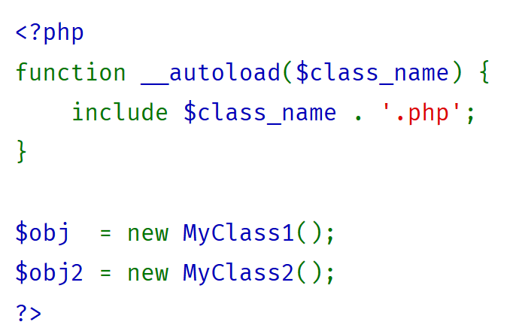
PHP: Autoload

Slide 25
PHP: __call
class ApiHandler
{
private $_apis = array( 'foo' => 'libfoo_foo',
'bar' => 'libfoo_bar');
public function __call($func, $args)
{
if (array_key_exists($func, $this->_apis)
{
$funcName = $this->_apis[$func];
call_user_func_array($funcName, $args);
}
}
}
// ...
$d = deserialize($_GET['foo']);
$d->validate();

Slide 26
PHP: Magic properties
class SomeObj
{
public function __get($name)
{
switch ($name)
{
case “foo”:
return get_foo();
// ...
}
return FALSE;
}
}
$auth_token = deserialize($_GET['token']);
if ($auth_token->is_expired === FALSE)
{
// ...
}

Slide 27
PHP: Other bits
__toString()
__clone()
__invoke()
__debugInfo()

Slide 28
PHP: Buggy stuff
CVE-2014-3669: Integer overflow (DoS)
CVE-2014-8142: Use after free (DoS/RCE?)
CVE-2015-0273: Use after free (RCE)

Slide 29
Fixes
Don't deserialise ANYTHING from the user.
Use “dumb” formats like JSON where possible, we have json_decode() for this!
Digitally sign data if it has to be transmitted.
Verify your data before using it, at the point of use.

Slide 30
.NET Attack Surface
Unexpected incoming types
Implicit logic (e.g. destructors)
Deserialisation callbacks
“Pointer” types (delegate, event)
Unmanaged resources

Slide 31
.NET: Example Code
string Deserialise(byte[] data)
{
using (var ms = new MemoryStream(data))
{
var bf = new BinaryFormatter();
return (string)bf.Deserialize(ms);
}
}
// ...
string result = Deserialise(data);

Slide 32
.NET Example - Execution
string Deserialise(byte[] data)
{
using (var ms = new MemoryStream(data))
{
var bf = new BinaryFormatter();
return (string)bf.Deserialize(ms);
}
}
// ...
string result = Deserialise(data);
non-string data
InvalidCastException

Slide 33
.NET Example – IL Disassembly
.locals init (
[0] class MemoryStream ms,
[1] class BinaryFormatter bf,
[2] class string CS$1$0000
)
...
IL_000e: ldloc.0
IL_000f: callvirt BinaryFormatter::Deserialize(class Stream)
IL_0014: castclass System.String
IL_0019: stloc.2
...
IL_0026: ldloc.2
IL_0027: ret

Slide 34
.NET Example - Steps
The MemoryStream object is pushed to the evaluation stack.
Call BinarySerializer.Deserialize()
The returned object is pushed to the top of the evaluation stack.
The castclass opcode casts the item on the top of the evaluation stack to type System.String.
The result is stored in local variable index 2.
Later, local variable index 2 is pushed to the evaluation stack to be returned.

Slide 35
.NET Example - Attack
IL_000f: callvirt instance object BinaryFormatter::Deserialize(class Stream)
{
deserialise from Stream into temp Object variable
push temp Object to evaluation stack
}
IL_0014: castclass System.String
{
pop Object variable from evaluation stack
cast to type System.String
push System.String typed variable to evaluation stack
}
Object deserialised and stored in eval stack temporarily
Data contains
unexpected type
Casting temporary object to type System.String
InvalidCastException
But... the object already exists!

Slide 36
.NET Example – Attack [2]
Instance of passed object now exists in heap
No references
GC pass = object destroyed
Destructor called!

Slide 37
.NET Example – Attack Vectors
Any serialisable type that does something in its destructor (note: NOT the same as Dispose)
Candidates:
  System.CodeDom.Compiler.TempFileCollection
  System.IO.FileSystemInfo
  System.Management.IwbemClassObjectFreeThreaded
Thanks for James Forshaw for finding these! ^

Slide 38
.NET Example – Impacts
TempFileCollection: Arbitrary file deletion.
FileSystemInfo: Cause SMB request (cred relaying / token theft)
IWbemClassObjectFreeThreaded: NTLM cred reflection via remote DCOM/WMI, or arbitrary COM object creation.

Slide 39
Real world examples
Context's Canape tool (CVE-2014-9138)
Paint.NET (CVE-2014-9139)
Some in the pipeline...
Plenty more out there!

Slide 40
.NET Callbacks
OnDeserialized / OnDeserializing callbacks
IDeserializationCallback interface
IObjectReference interface (GetRealObject)
Exploited just like we did with PHP

Slide 41
.NET Delegates and Events
These act like pointers, but managed.
If we serialise an object with them, method “handles” get transferred.
We can tweak these!
Point to other methods → code exec.

Slide 42
.NET Unmanaged Resources
Accessing unmanaged memory (e.g. with Marshal) can be dangerous
Serialising may lead to case where unmanaged pointers are arbitrarily controllable.
  Read-what-where
  Write-what-where
  Other memory corruption

Slide 43
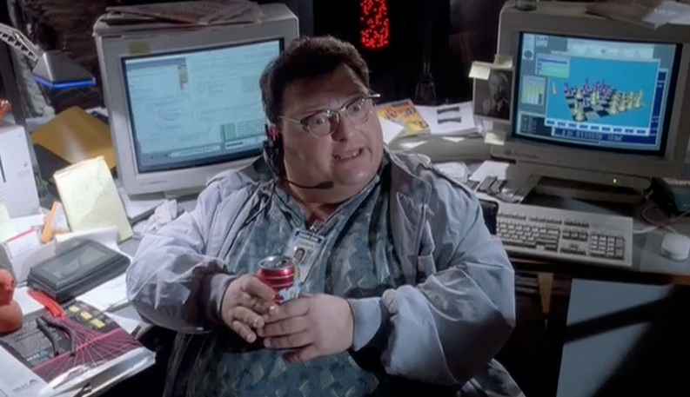
Fixes

Slide 44
Fixes
Don't deserialise ANYTHING from the user.
Use “dumb” formats like JSON (if applicable) and manually create new objects from this.
Ensure types are enforced (e.g. binders)
Digitally sign data if it has to be transmitted.
Verify your data before using it, at the point of use.
Avoid events, delegates, unmanaged resources in serialisable types.

Slide 45
.NET Type Filtering
class MyBinder : SerializationBinder
{
public override Type BindToType(string assemblyName, string typeName)
{
if (assemblyName == “mscorlib” && typeName == “System.String”)
{
return base.BindToType(assemblyName, typeName);
}
else
throw new TypeLoadException(“Bad type requested!”);
}
}
var bf = new BinaryFormatter();
bf.Binder = new MyBinder();

Slide 46
Java
Mostly the same, with some added flaws
Potential arbitrary bytecode exec with ClassLoader's defineClass / resolveClass
Memory exhaustion (e.g. HashMap with huge loadFactor)
CVE-2012-2739: HashMap CPU-exhaustion DoS via large numbers of identical hashes.

Slide 47
Fixes
Don't deserialise ANYTHING from the user.
Use look-ahead deserialisation in Java SE.
Digitally sign data if it has to be transmitted.
Verify your data before using it, at the point of use.
Avoid doing anything funky with ClassLoader.

Slide 48
So little time
Security issues with deserialisation is a huge and complex topic
Can't cover it all here – no time!
If you're interested about MOAR info, come chat to me (or tweet me)

Slide 49
Acknowledgements & Thanks
James Forshaw (@tiraniddo)
Rick Brewster (Paint.NET dev)
Abertay Ethical Hacking Society
My fianceé for putting up with me!
You folks for listening to me ramble

Slide 50
// end
Questions? Comments?
Offers to buy me beer?
Much thanks.
“We don't take kindly to your types around here!”
Graham Sutherland (@gsuberland)
Portcullis Computer Security

